Slide 1
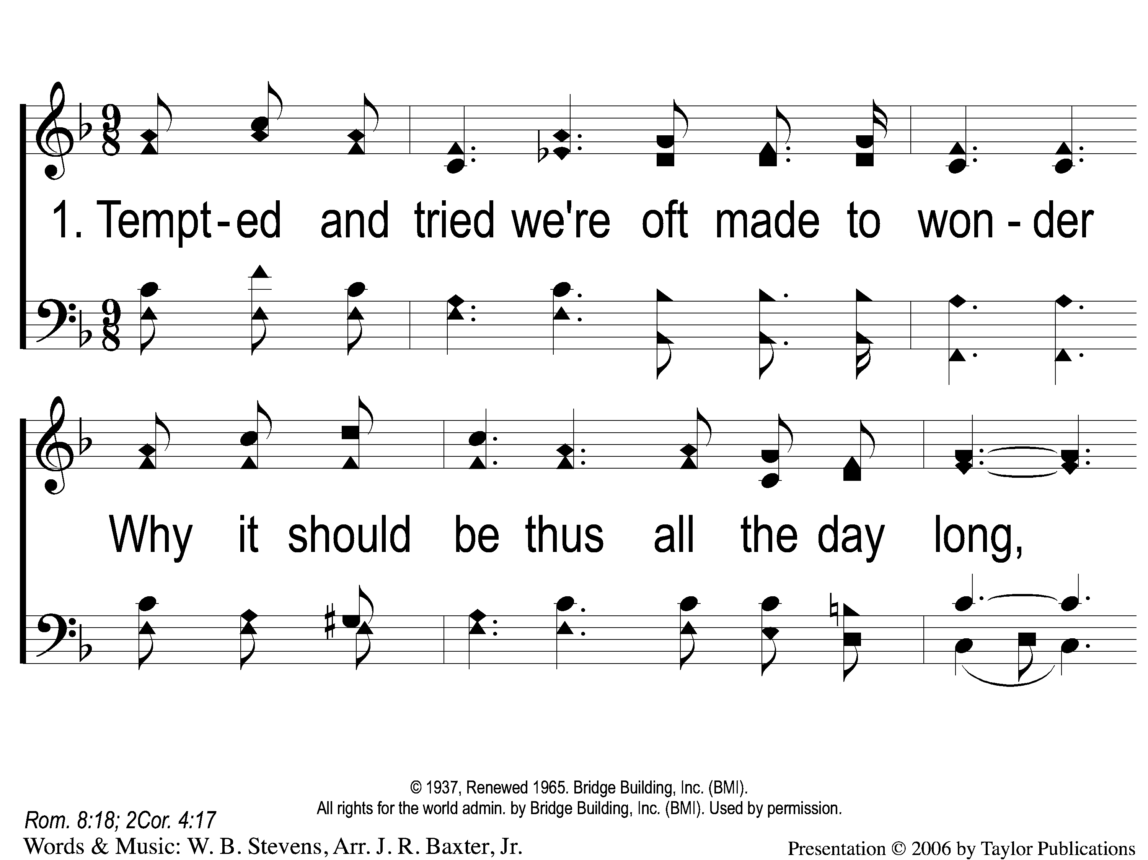
1-1 Farther Along
Farther Along
119

Slide 2
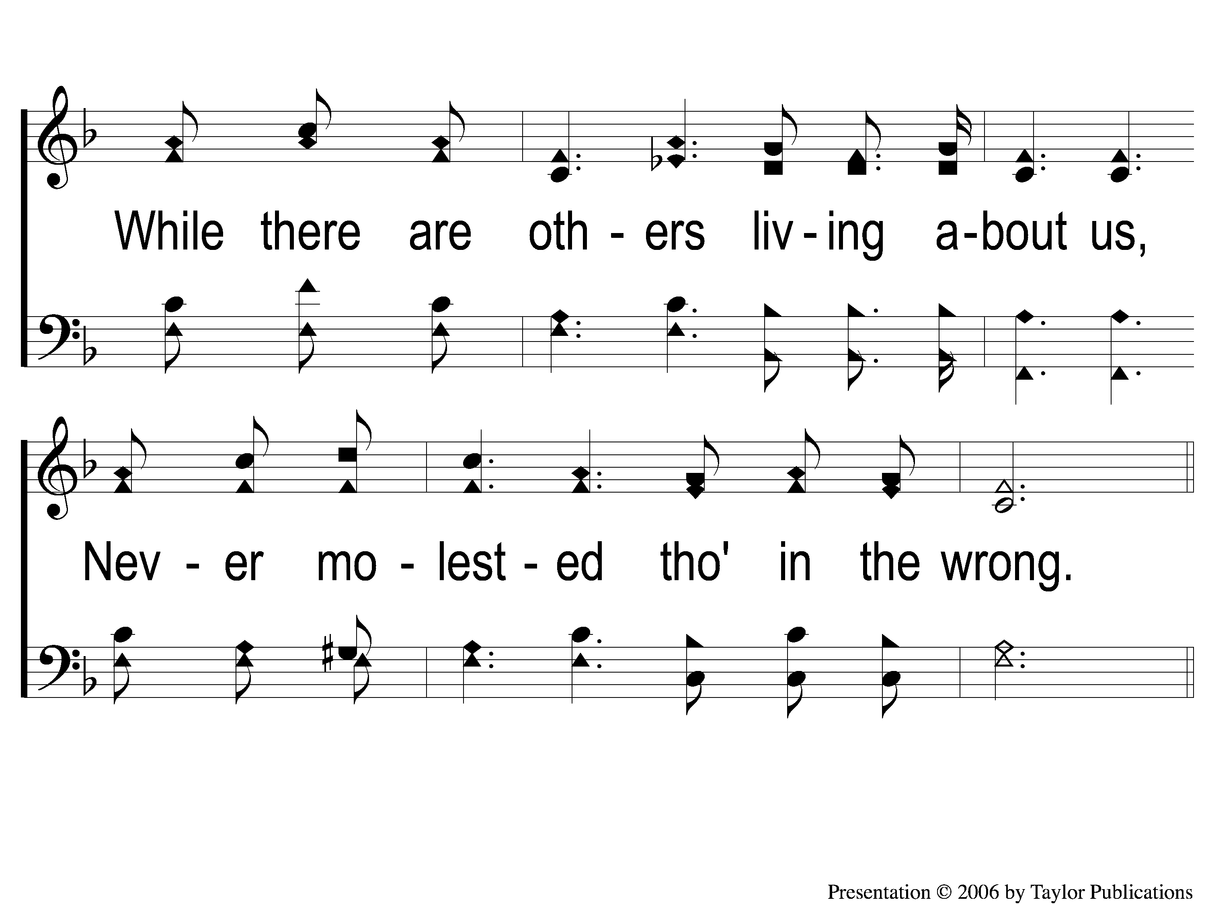
1-2 Farther Along
Farther Along
119

Slide 3
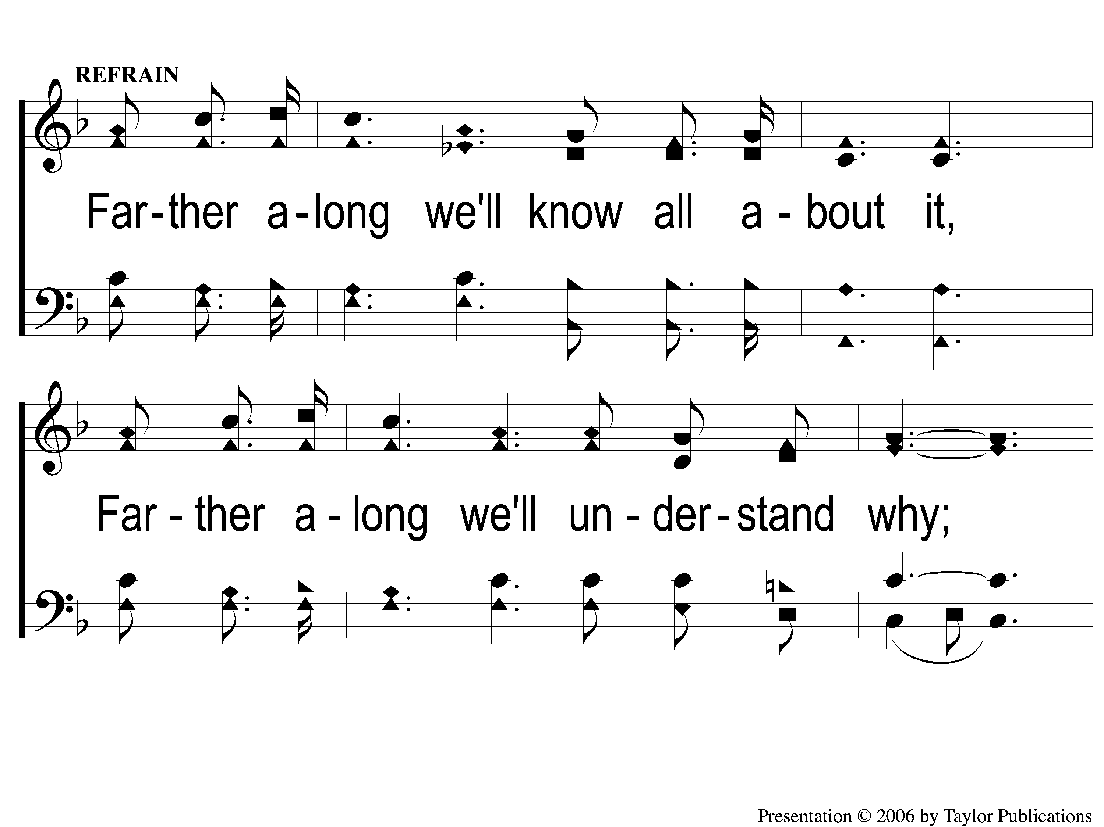
C-1 Farther Along
Farther Along
119

Slide 4
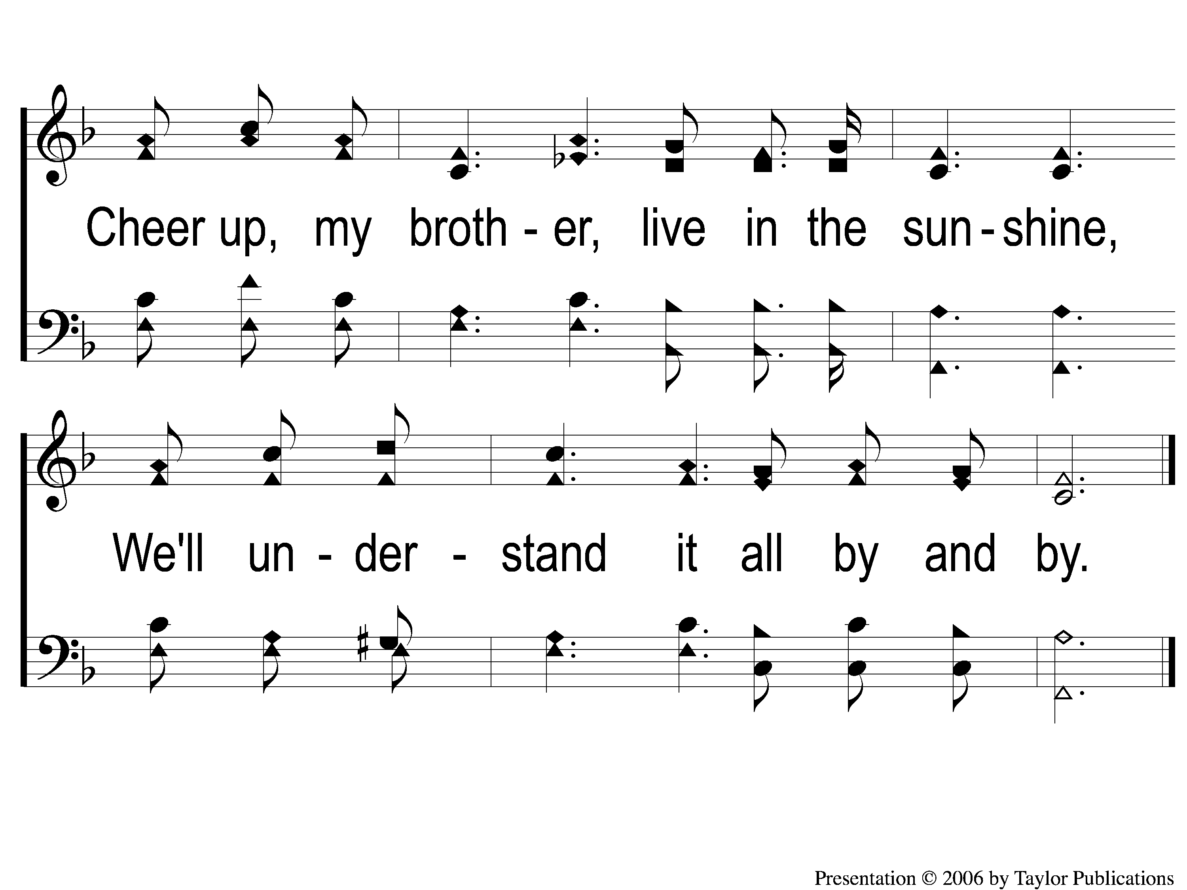
C-2 Farther Along
Farther Along
119

Slide 5
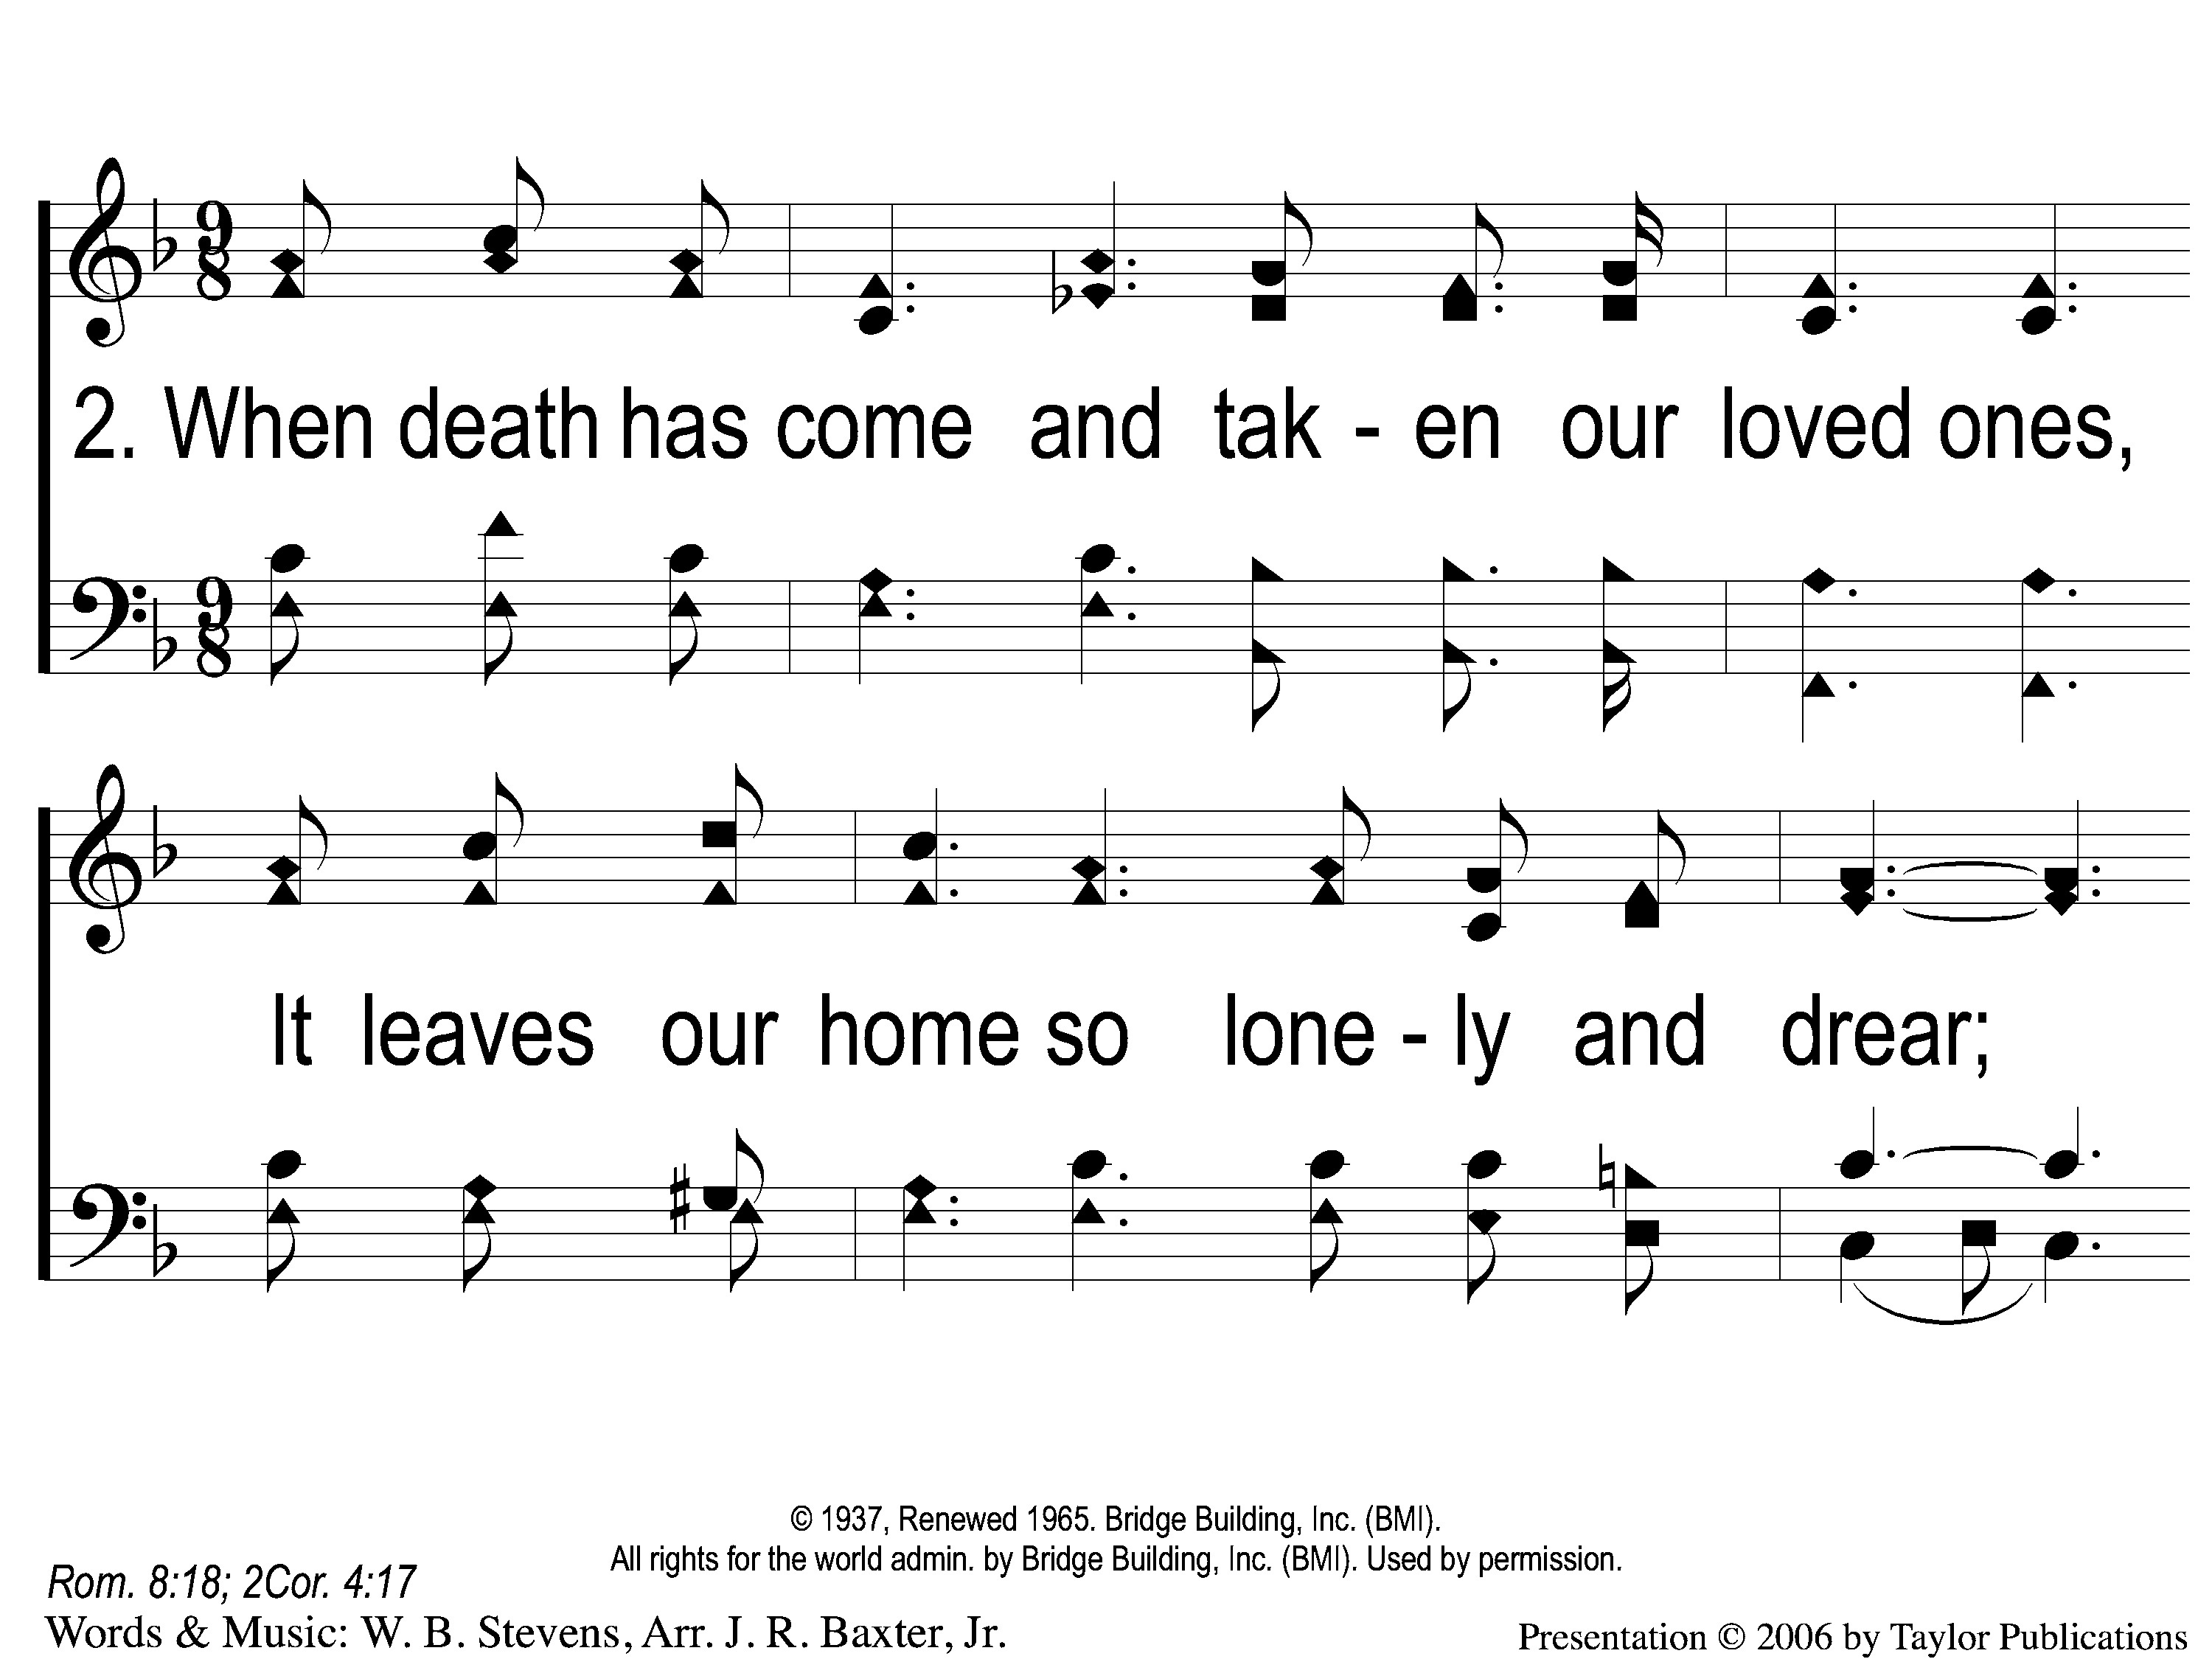
2-1 Farther Along
Farther Along
119

Slide 6
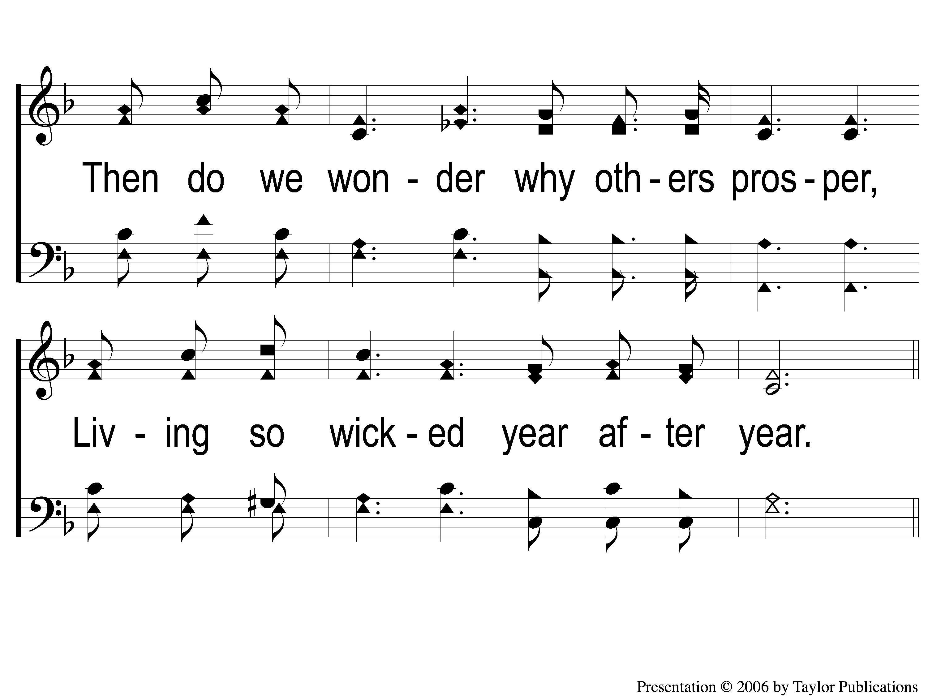
2-2 Farther Along
Farther Along
119

Slide 7
C-1 Farther Along
Farther Along
119

Slide 8
C-2 Farther Along
Farther Along
119

Slide 9
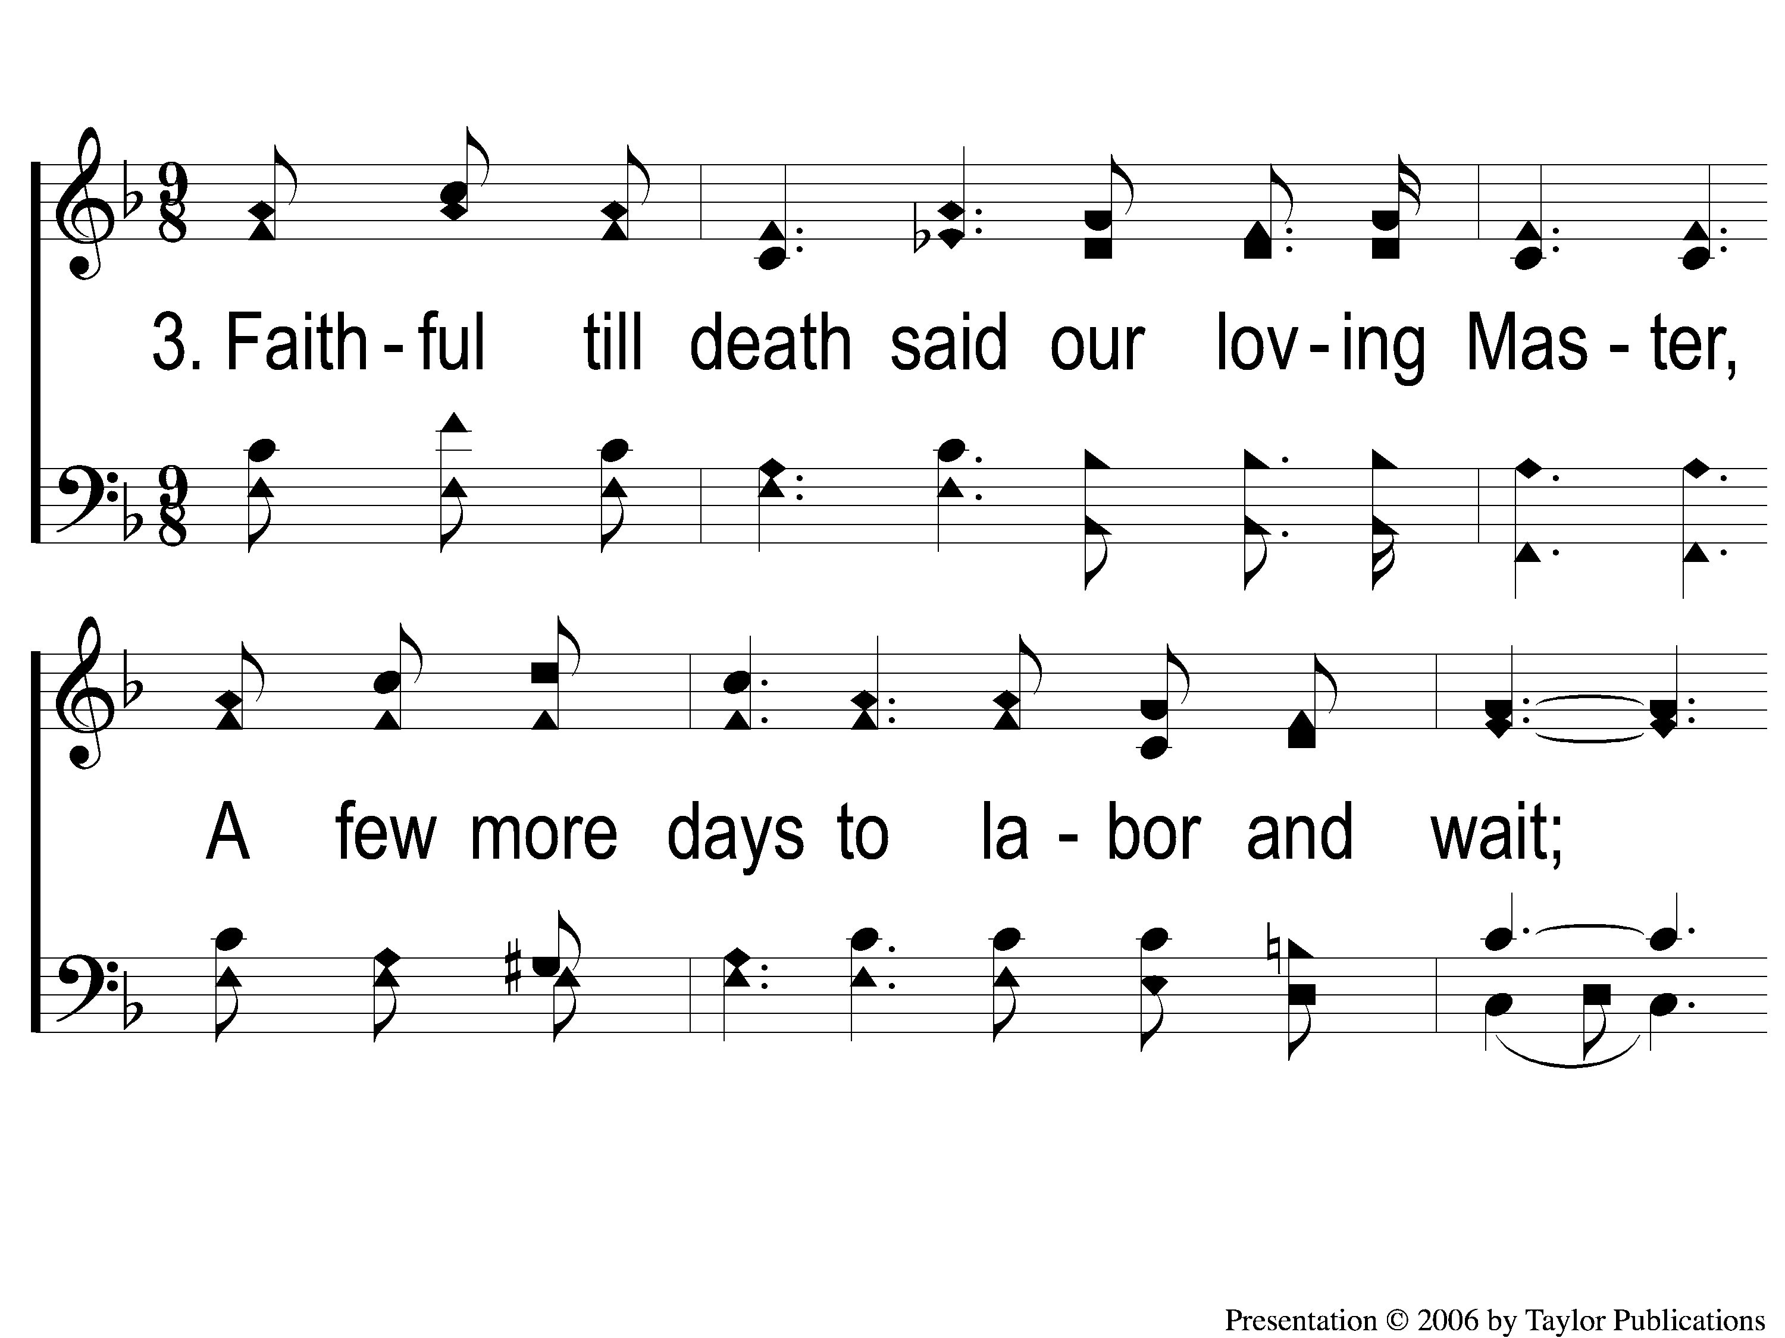
3-1 Farther Along
Farther Along
119

Slide 10
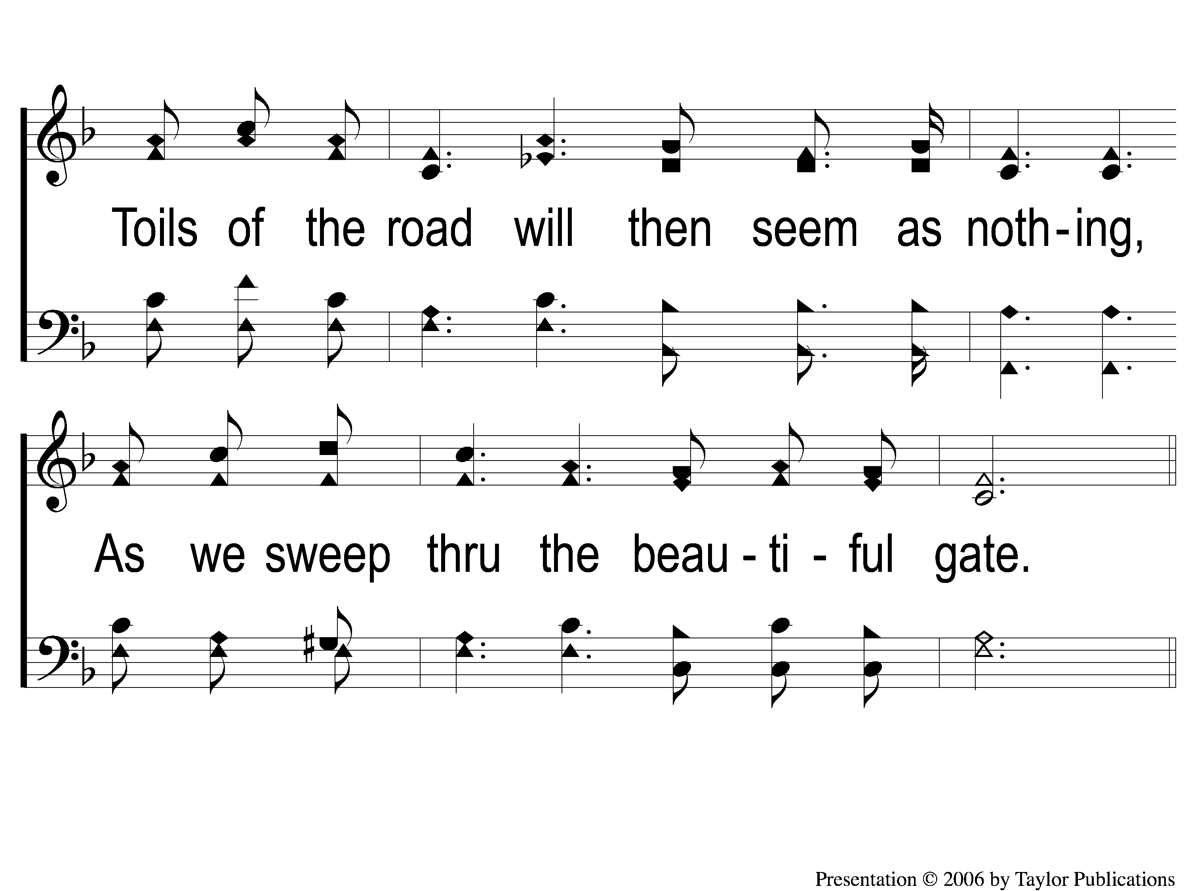
3-2 Farther Along
Farther Along
119

Slide 11
C-1 Farther Along
Farther Along
119

Slide 12
C-2 Farther Along
Farther Along
119

Slide 13
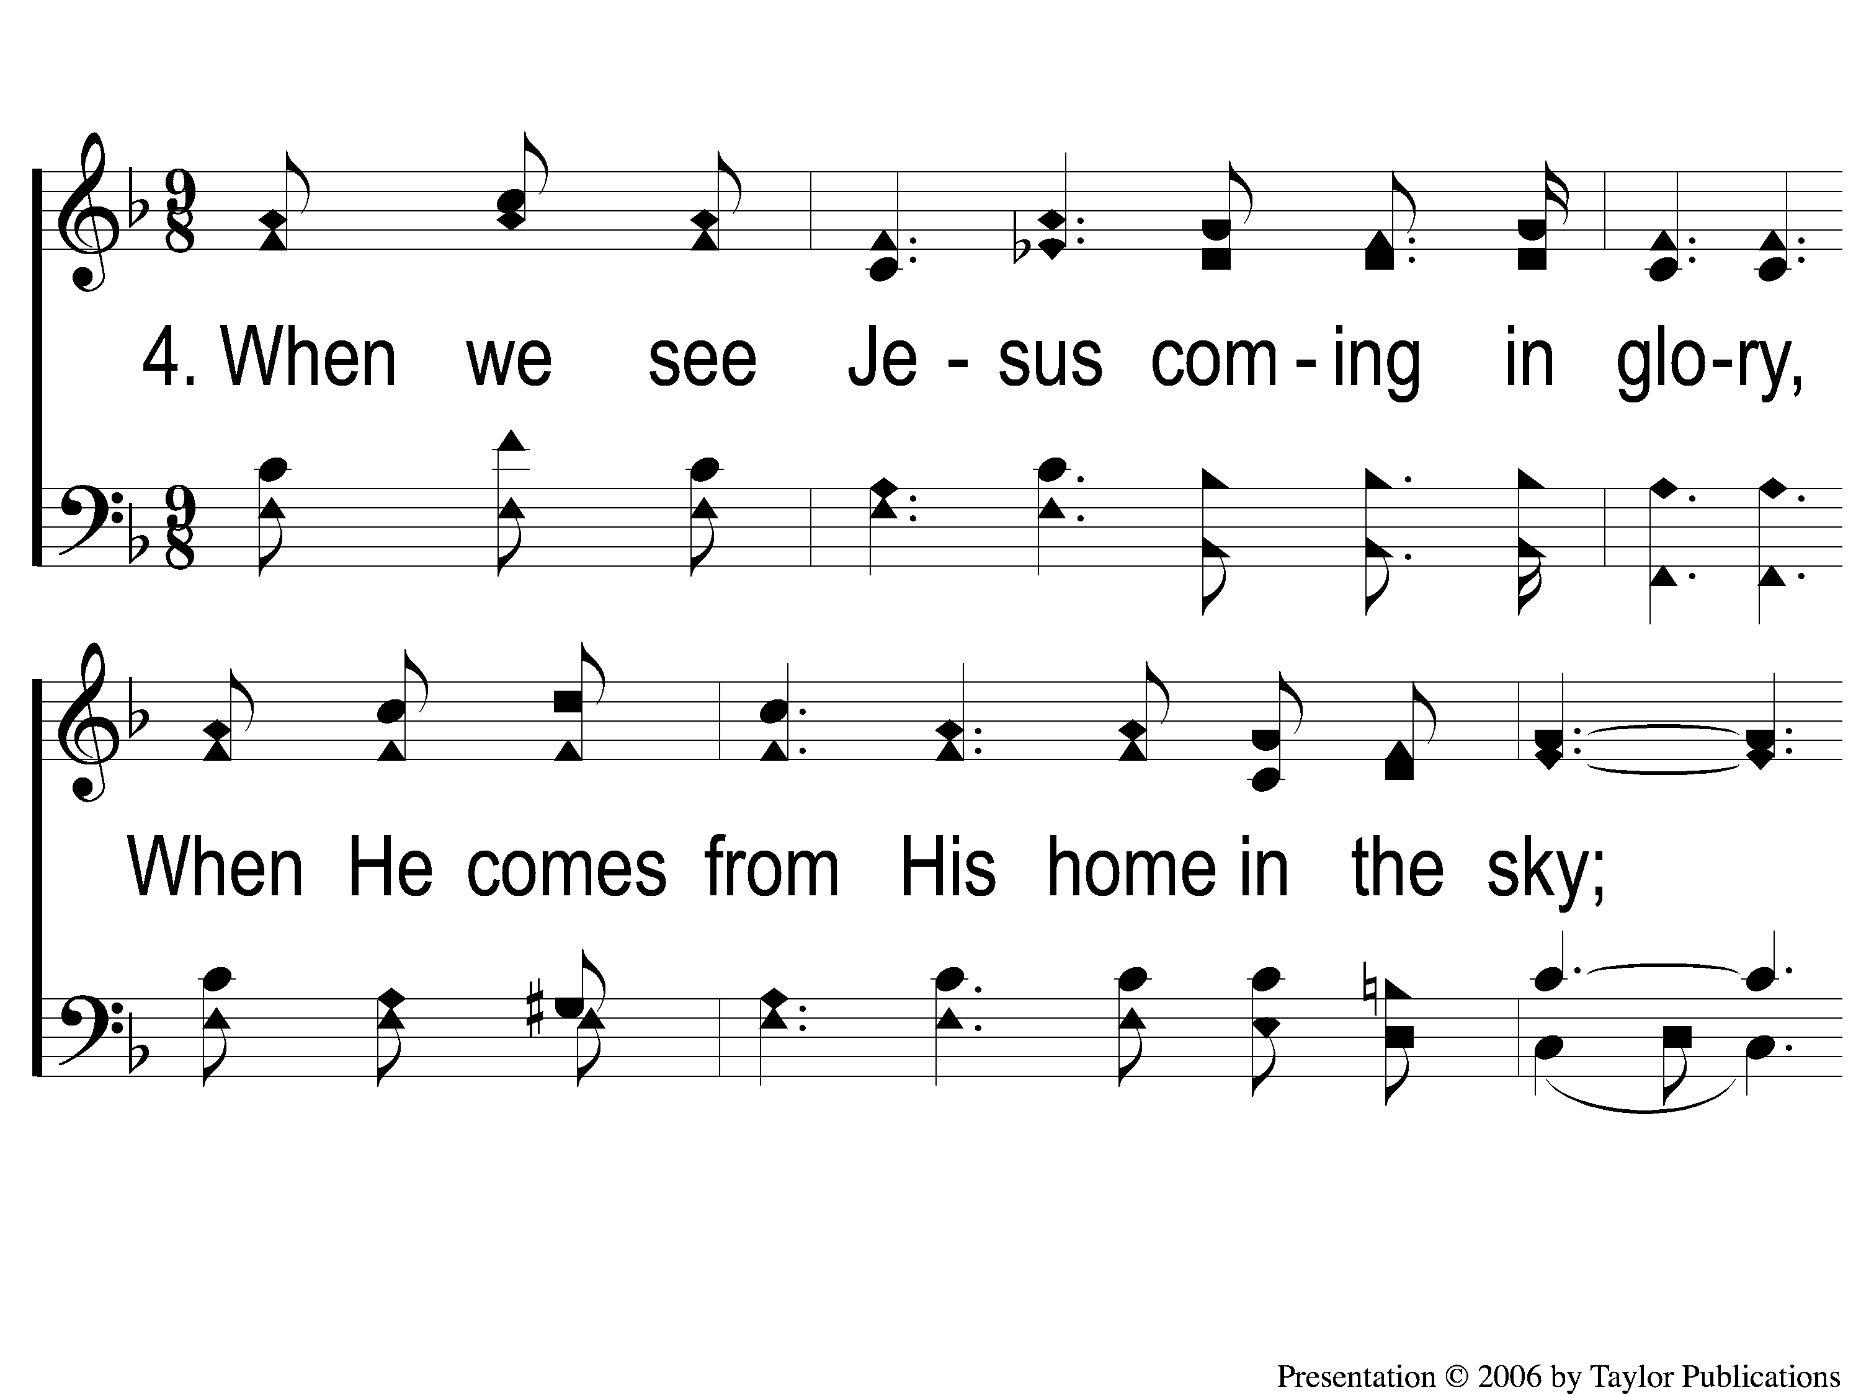
4-1 Farther Along
Farther Along
119

Slide 14
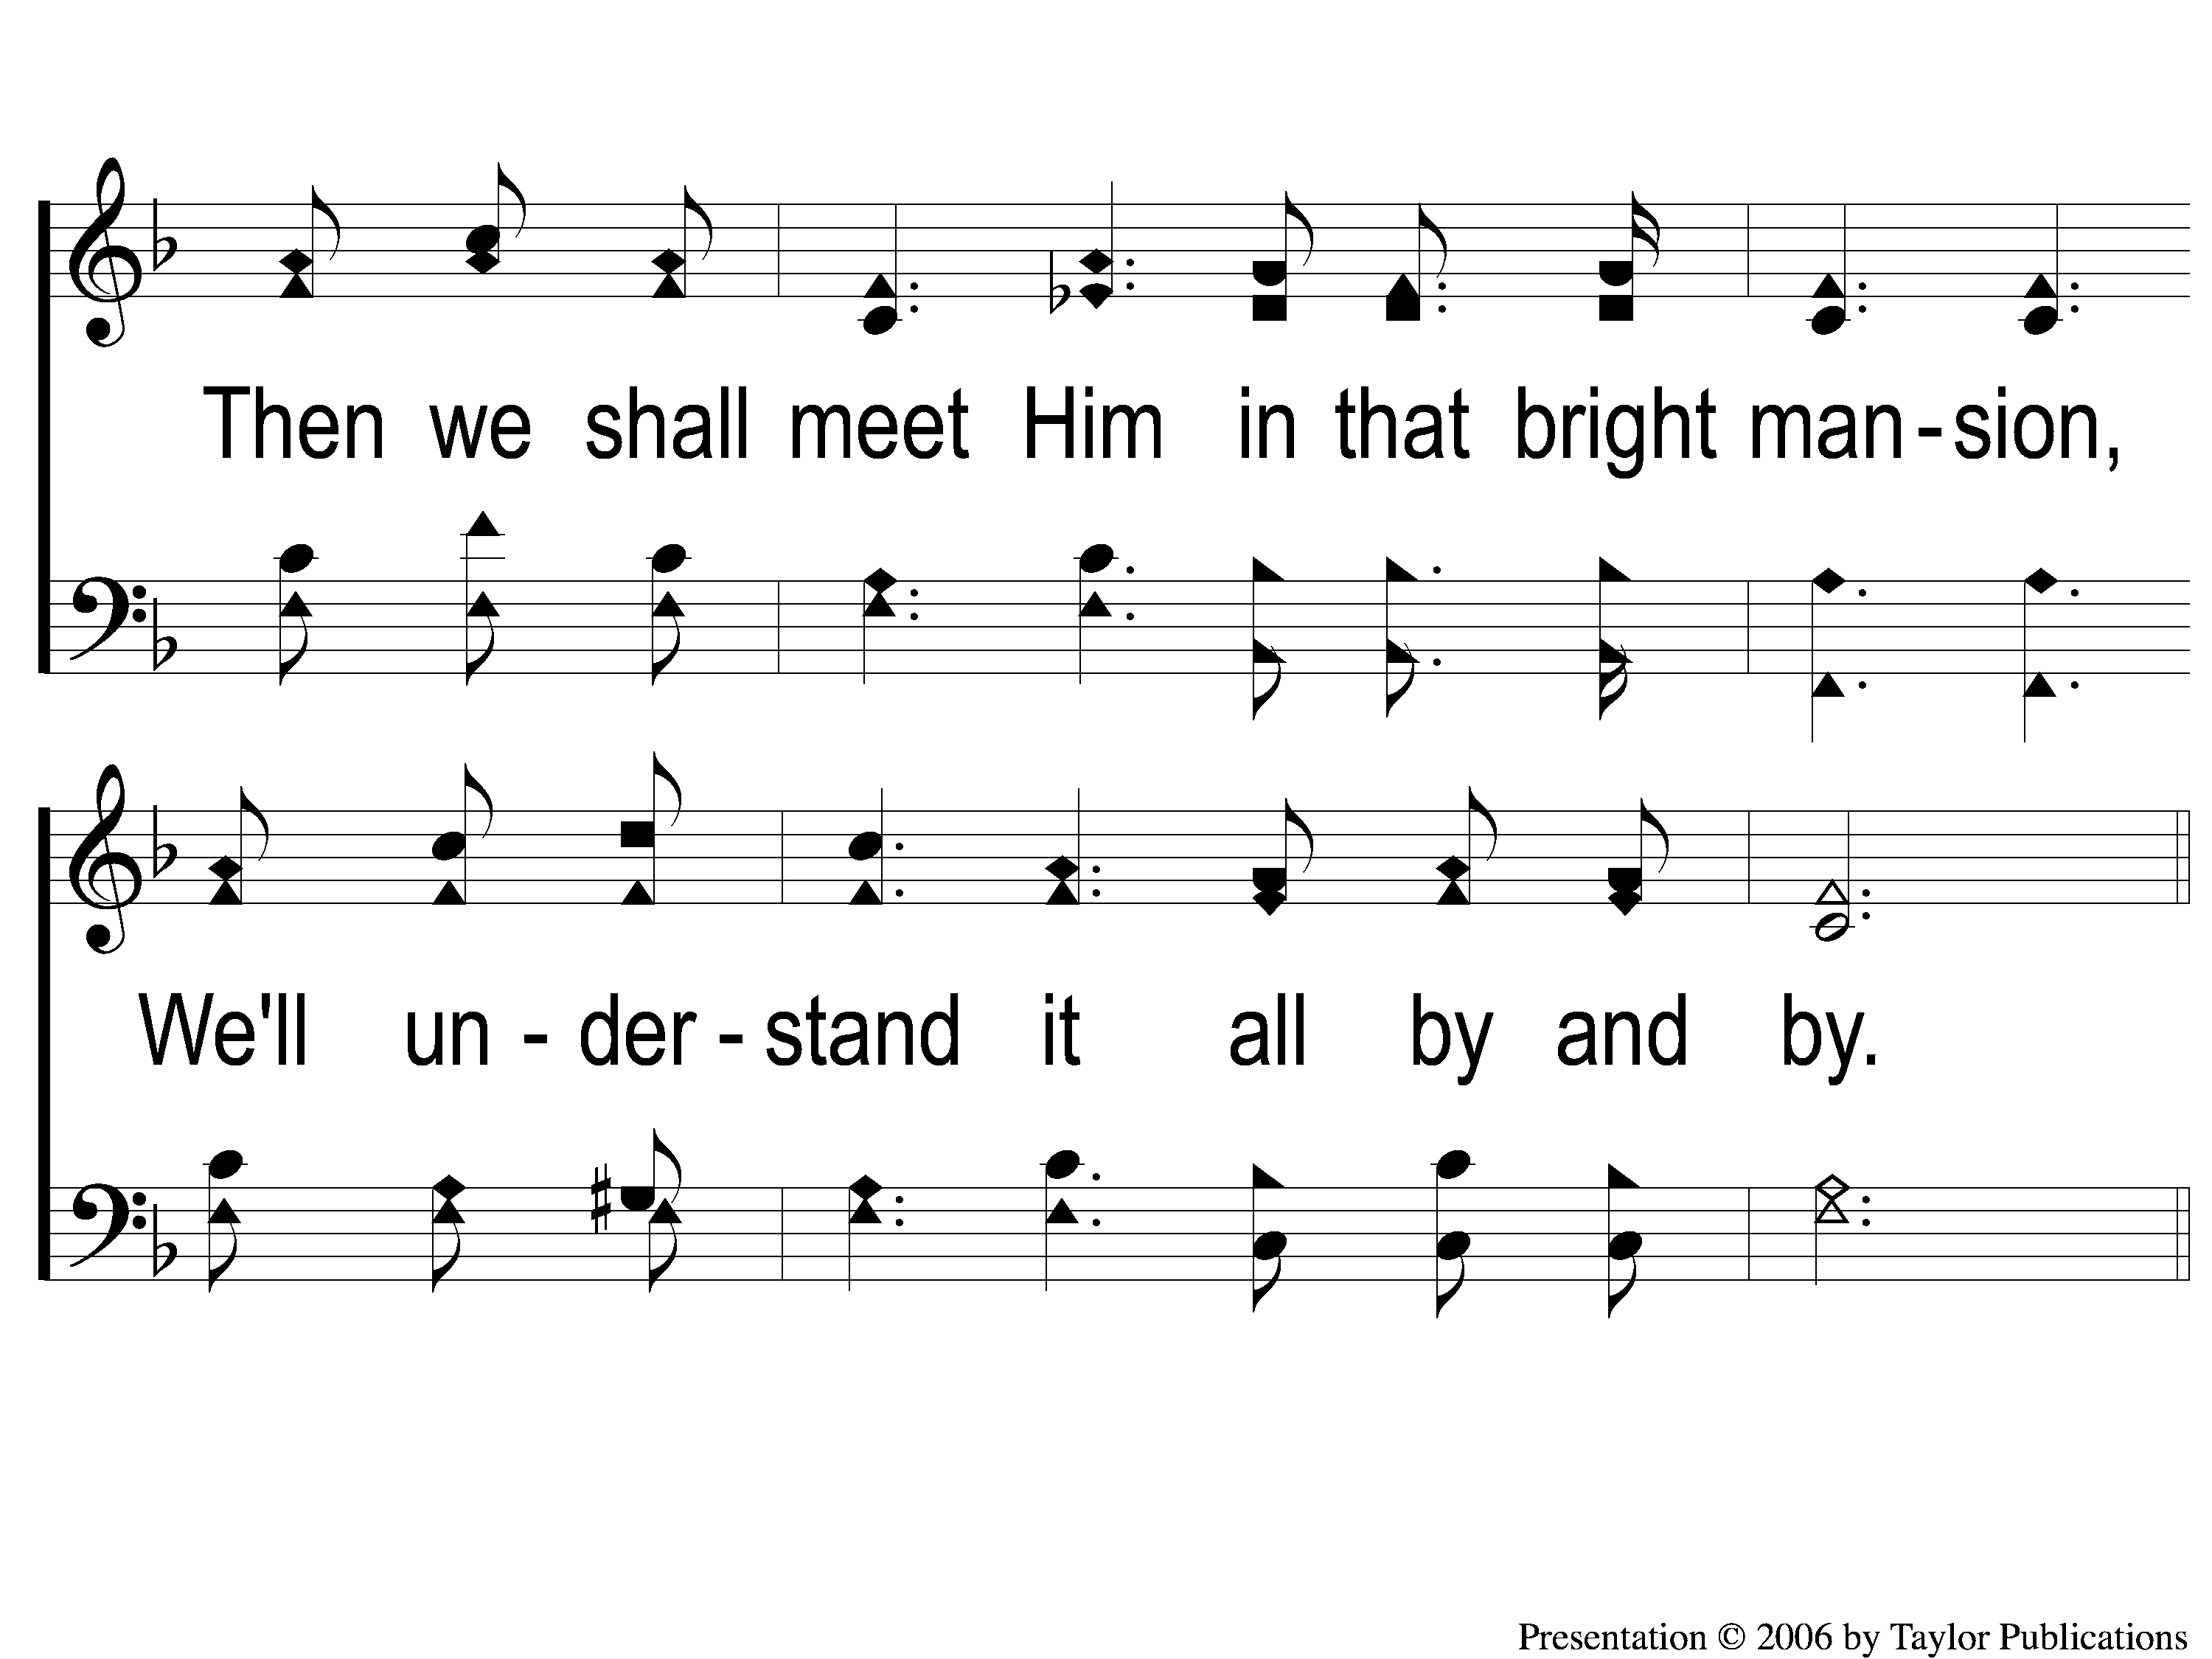
4-2 Farther Along
Farther Along
119

Slide 15
C-1 Farther Along
Farther Along
119

Slide 16
C-2 Farther Along
Farther Along
119

